Slide 1
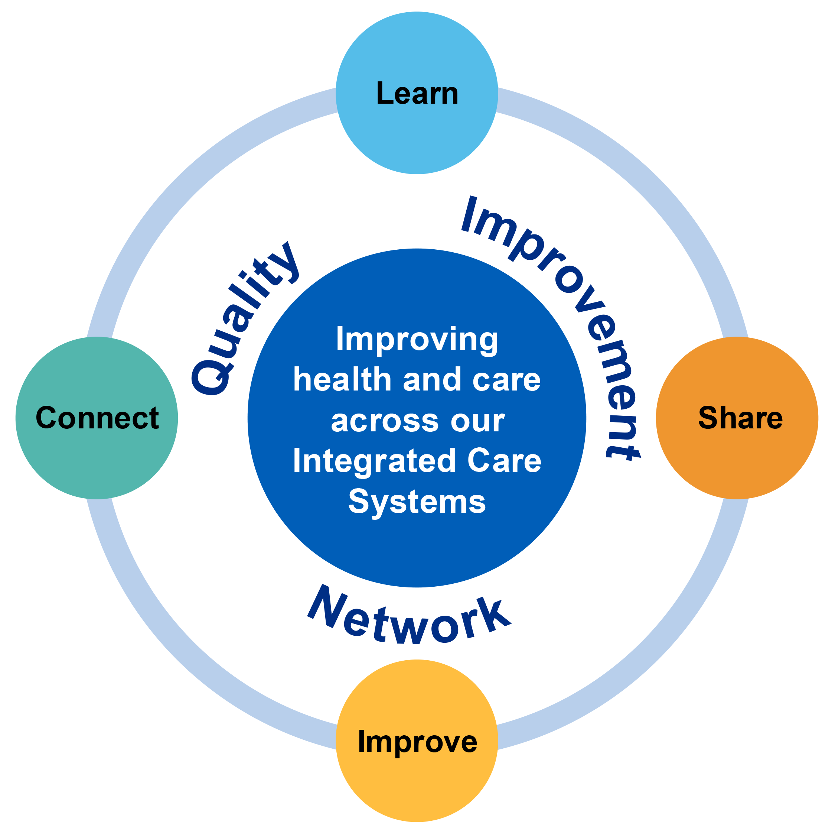
Continuous Improvement Case Study (Project Title here)
Background ….. who, what, why?
General background and context, what is the problem you are trying to solve?
Project led by: here
Service/Team: here
Aim
Approach
Measured Outcomes
Which cohort of patients/customers will this improvement impact and how?
Improved patient outcomes and/or experience
Improved staff satisfaction
Savings through time/reduced risk/financial and environmental.
Demonstrate changes introduced against each QI principles:
PDSA
Process/Standard work introduced
Reduced waste
Add value
Increase flow
Mistake proofing
Engagement – voice of the customer.
Baseline and outcome measure to test if change was an improvement?
*** TIP *** USE VISUALS)
Next steps/Opportunities for shared learning
Project Contact details and recognition of support involved
Remeasure at? date?
Communicate outcomes to?
Share & spread – can we identify opportunities for scale and spread into other areas across our Integrated CareSystem?
Can we learn from the challenges experienced?
Project lead and Contact details: here
This project was led by (provider logo)
And supported by (list all partners involved)
Get in touch with your system QI ideas, to share your QI story, general QI queries or to join us at our quarterly system Quality Improvement Network events. Email us: systemCQI@mpft.nhs.uk
Case Study No: 0000

